Slide 1
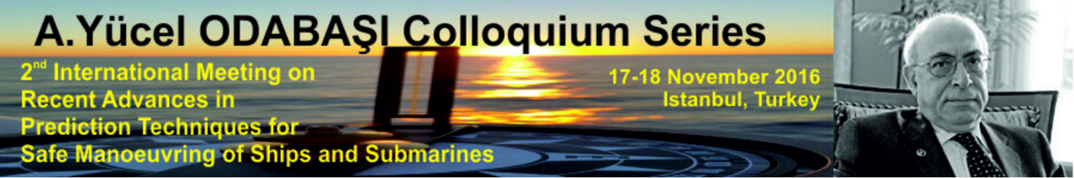
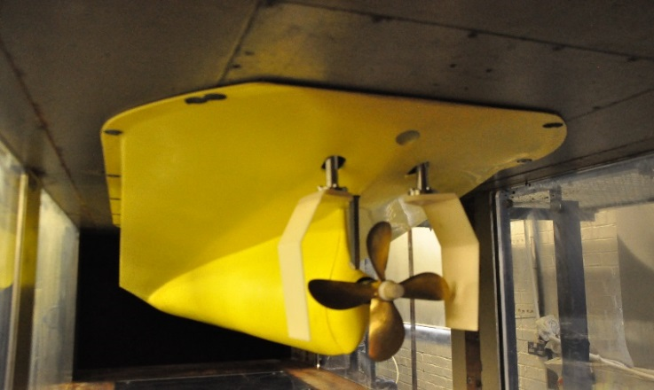
presented by
Serkan Turkmen
The Gate Rudder application to improve
poor course keeping ability of ships

Slide 2
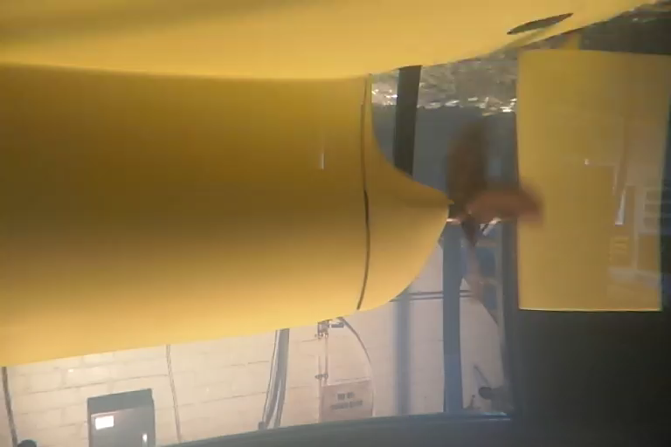
Background
Pros of Conventional Rudders
large turning moment (location)
large steering force supported by a propeller
recovery of rotational energy of a propeller
Cons of Conventional Rudders
longer stern for the space
additional resistance
cavitation erosion
vibration and noise
Poor course keeping for beamy ships (high fullness)
In most cases it might be required to install Energy Saving Devices (ESD) and high-lift rudder area to overcome the above mentioned disadvantages.
An alternative solution to this can be the “Gate Rudder”, a twin rudder system with two rudders at each side of a propeller.

Slide 3
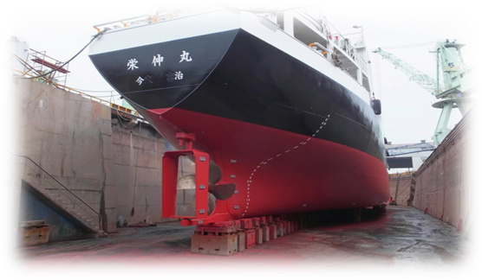
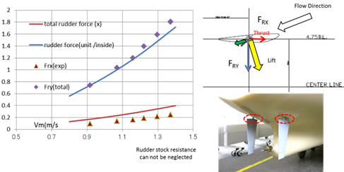
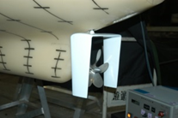
Background
Energy saving potential
based on the rudder thrust (duct effect)
induced by
- the cambered twin rudder blades
- efficiently accelerated propeller flow
Concept tested and modified at NMRI led by Dr. N. Sasaki.
Full-scale tests with “Frame Rudder” not satisfactory (2011) later replaced by two stocks driving two individual, asymmetric blade system to improve manoeuvrability,
the duct effect provides additional thrust and hence power saving.

Slide 4
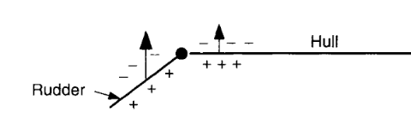
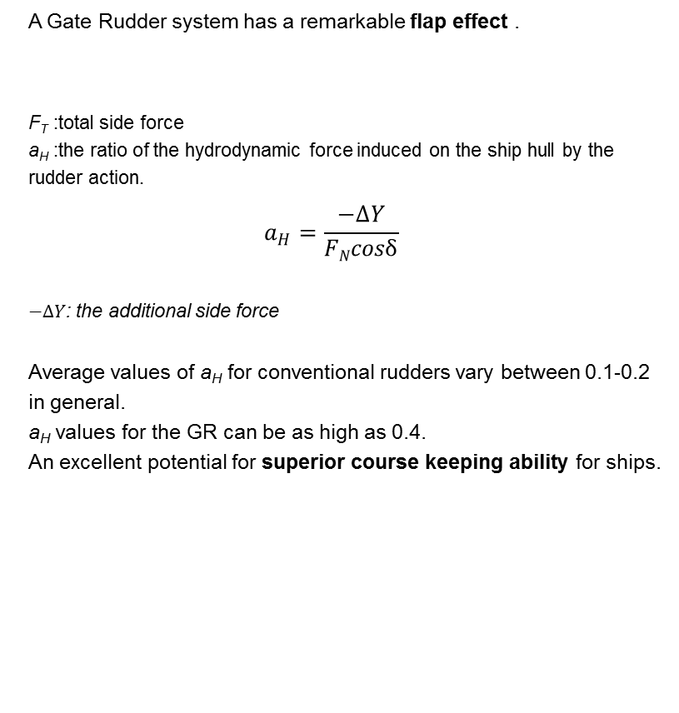
Background
A Gate Rudder system has a remarkable flap effect .
F_{T} :total side force
a_{H} :the ratio of the hydrodynamic force induced on the ship hull by the rudder action.
$$a_{H}=\frac{−∆Y}{FNcosδ}$$
$−∆Y$: the additional side force
Average values of a_{H} for conventional rudders vary between 0.1-0.2 in general.
a_{H} values for the GR can be as high as 0.4.
An excellent potential for superior course keeping ability for ships.
F_{T} = F_{N}cosδ(1+a_{H})
Conventional Rudder
Gate Rudder
An efficient manoeuvring of ships by exploiting the interaction between the twin rudder blades and the ship stern.

Slide 5
Objectives
Carchen et al. (2016)* explored various manoeuvring aspects of the GR application using the enhanced MMG model.
The main objective of the current study was the application of the CR and GR systems to different hull forms in order to evaluate the course keeping performances by using the enhanced MMG model.
*Carchen, A., Shi, W, Sasaki, N. and Atlar, M. (2016) A prediction program of manoeuvrability for a ship with a gate rudder system. A. Yücel Odabaşı Colloquium Series - 2nd International Meeting on Recent Advances in Prediction Techniques for Safe Manoeuvring of Ships and Submarines. Istanbul, Turkey. November 2016.

Slide 6
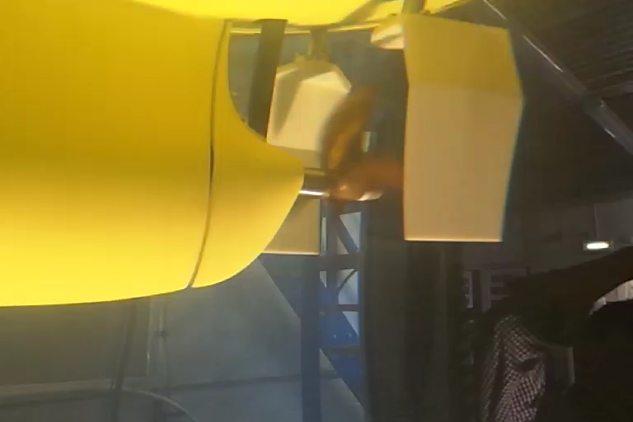
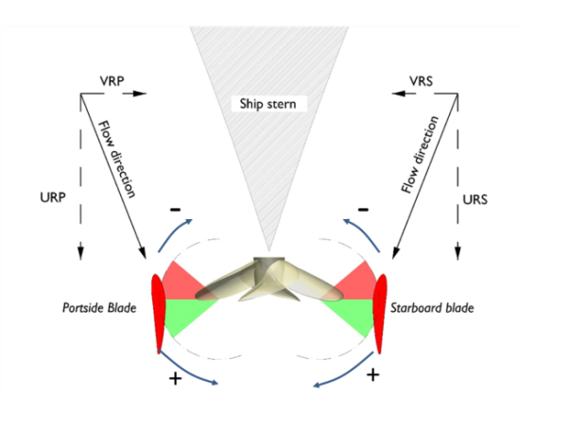
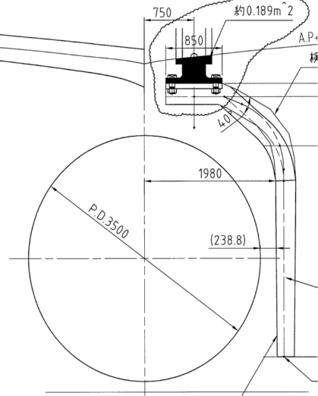
Methodology
a modified MMG model was used to predict the course keeping ability.
As the gate rudder has two blades beside a propeller, the flow fields depend not only on the rudder angle but also on the propeller rotation direction.

Slide 7
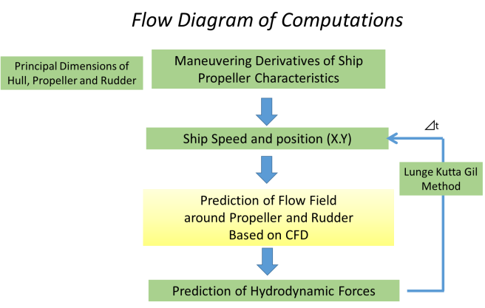
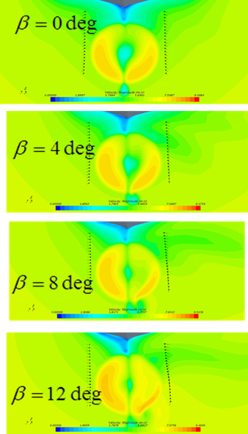
Methodology
Runge Kutta Gil Method
The prediction of this flow field by CFD
The propeller performance characteristics (thrust, torque, advance speed) introduced in the CFD model as a momentum source.
Multiple regression analysis used to estimate normalized velocities as a function of the drift angle β (0-35deg ) and the range of effective inflow angle to rudder αR (50-130 and 230-310deg ).
Hull derivatives partly adopted from the studies of Sasaki et al. (2015), Yasukawa (2015) and Hirano (1981).
The flow field characteristics behind the stern for different drift angles

Slide 8
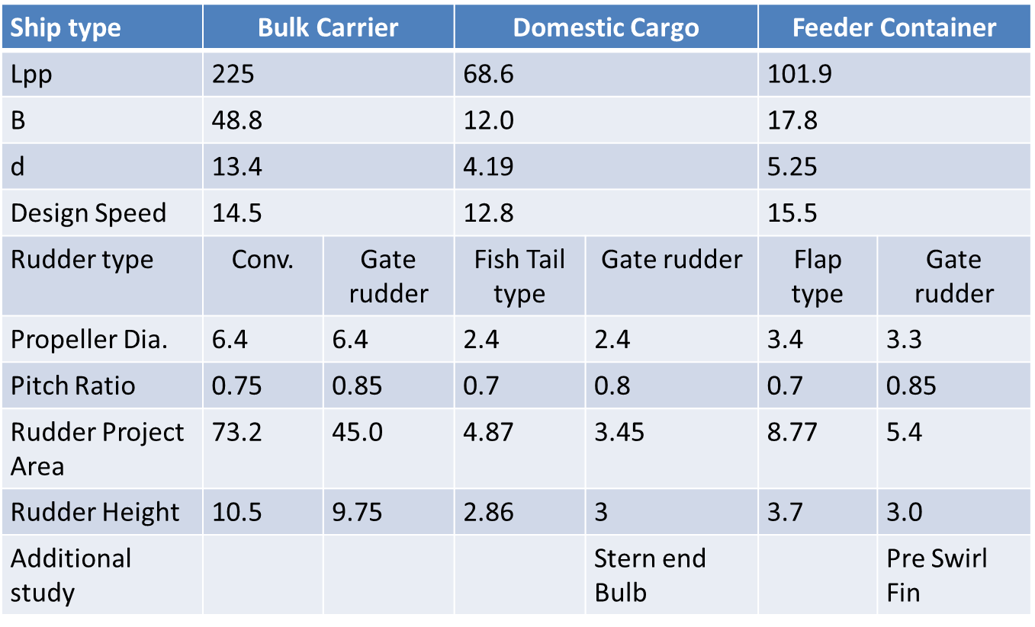
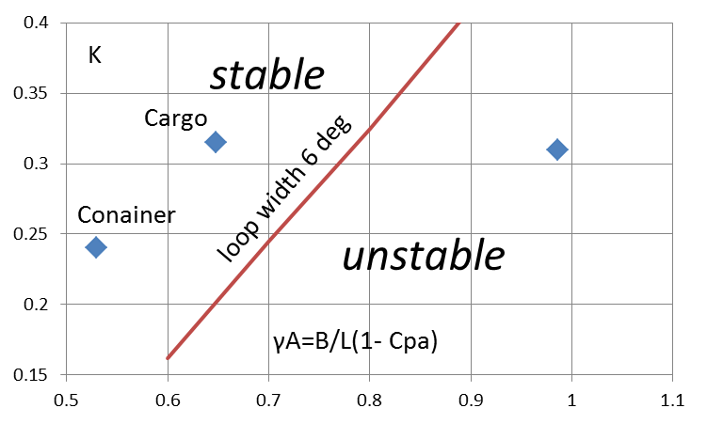
Case studies
The strong flap effect of the GR was demonstrated for three different hull types
Quick Chart of Course Keeping Ability
Bulk Carrier
The fullness parameter (γA) vs.the form factor K
Bulk Carrier is remarkably larger than the other two vessels.
The most important manoeuvrability feature of a beamy vessel is the course keeping ability.
Results should satisfy IMO regulations for Standards for Ship Manoeuvrability

Slide 9
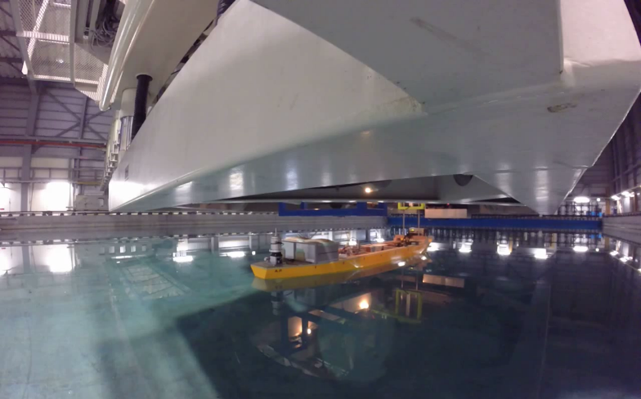
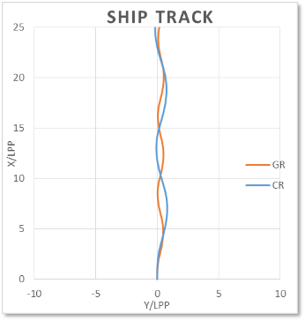
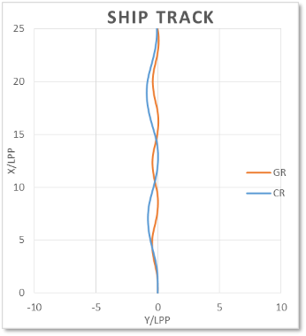
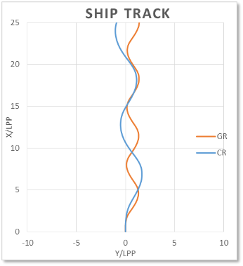
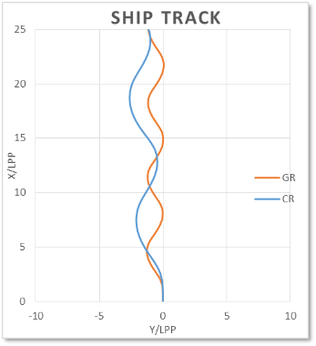
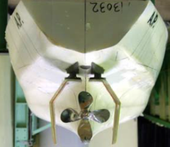
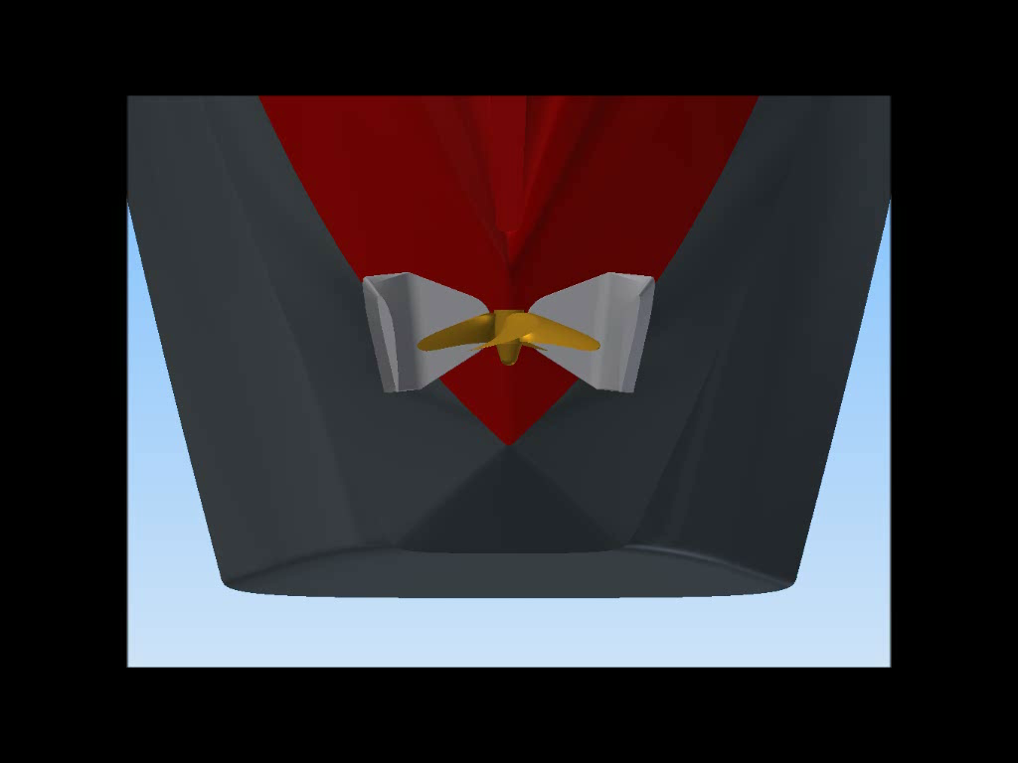

Case studies
1-Domestic Cargo
Zig-Zag manoeuvres ±10 degree
Towing tank model of Domestic Cargo used in Kyushu manoeuvring basin
The improvement on the course keeping can clearly be detected in the ±20 degree Zig-zag tests
The GR contribution to the Turning circle test outperformed the CR .
Zig-Zag manoeuvres ±20 degree
 | CR | GR | CR | GR
35° | Adv./L | Adv./L | Tact./L | Tact./L
+35(S) | 4.4 | 2.8 | 5.4 | 3.8
-35(P) | 4.0 | 2.9 | 4.7 | 3.8
MEAN | 4.2 | 2.8 | 5.0 | 3.8
2014
Turning circle test Advance and Diameter
2018
New Ship
(Delivery)

Slide 10
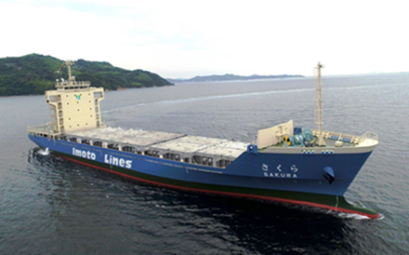
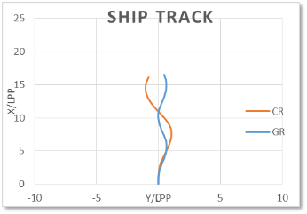
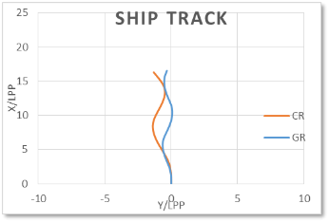
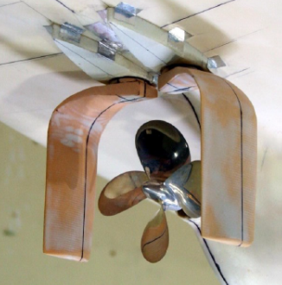
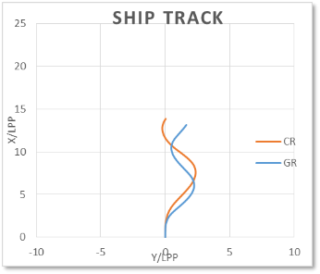
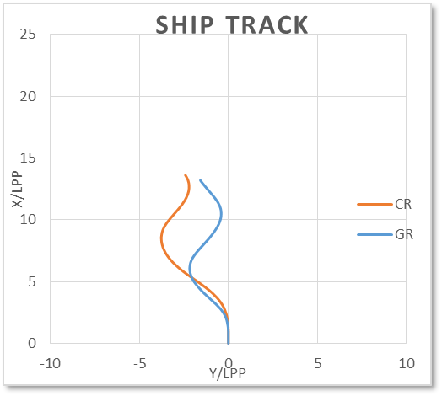
Case studies
2-Feeder Container
Zig-Zag manoeuvres ±10 degree
The vessel with the GR performs better than with the CR at the Z tests for overshoot angle ±10.
Zig-Zag manoeuvres ±20 degree
 | CR | GR | CR | GR
35° | Adv./L | Adv./L | Tact./L | Tact./L
+35(S) | 4.4 | 3.4 | 4.0 | 4.2
-35(P) | 4.1 | 3.4 | 3.6 | 4.2
MEAN | 4.2 | 3.4 | 3.8 | 4.2
2016
2017
New Ship
(Delivery)
Turning circle test Advance and Diameter

Slide 11
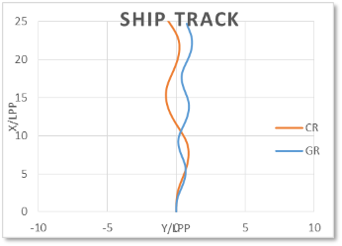
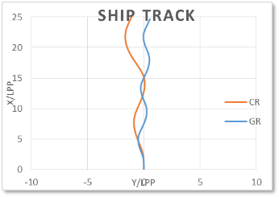
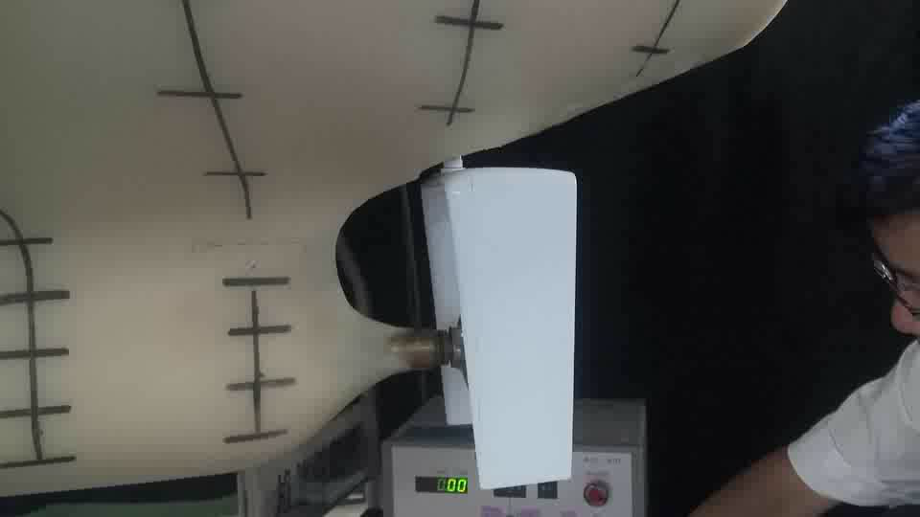
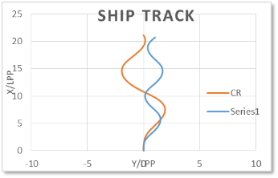
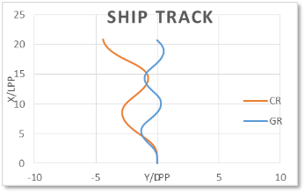
Case studies
3-Bulk Carrier
Zig-Zag manoeuvres ±10 degree
The CR shows poor course keeping performance for particularly ±20 Z test due to the fullness of the Bulk Carrier
Improvements take place when the GR system is used.
This improvement can be seen in the results of the turning circle test as well. IMO criteria were satisfied for both the CR and the GR.
Zig-Zag manoeuvres ±20 degree
 | CR | GR | CR | GR
35° | Adv./L | Adv./L | Tact./L | Tact./L
+35(S) | 4.5 | 3.2 | 4.5 | 3.5
-35(P) | 4.1 | 3.6 | 4.0 | 4.1
MEAN | 4.3 | 3.4 | 4.2 | 3.8
Turning circle test Advance and Diameter
400m towing tank test
Aframax Tanker
2019
Retrofit

Slide 12
Concluding remarks
All three cases showed that the modified MMG program can predict the manoeuvrability of the vessel with the GR as well as with the CR.
Unique hull derivatives are rudder-type independent -> course keeping improvement depended on the rudder and the operation condition.
The applications showed that the Gate Rudder system is able to improve the vessel’s course keeping ability.
The remarkable flap effect (a_{H}) of the GR increased the lateral forces and the yaw moment -> good course keeping ability.
The flap effect of the GR is the most significant factor for a Bulk Carrier that has the highest fullness. The findings highlight the significance of the GR and suggest that the GR system can be recommended for similar types of vessel.

Slide 13
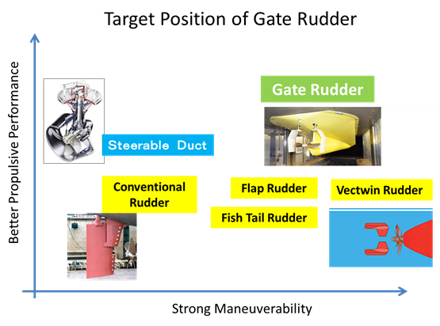
Concluding remarks
The GR system is an innovative, advanced application to improve ship manoeuvring capabilities, it can also be used as an energy saving device.

Slide 14
Do we have still time for 2 more slides ?

Slide 15
?
What happened to the Frame Rudder

Slide 16
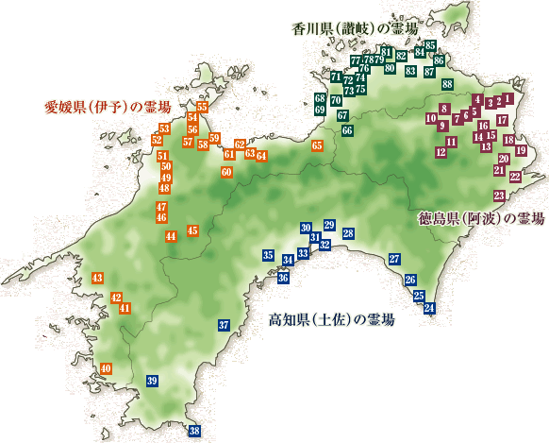
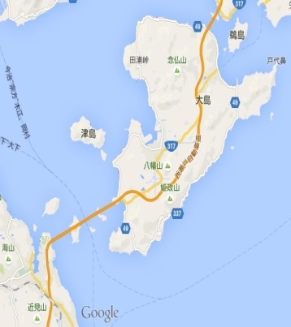

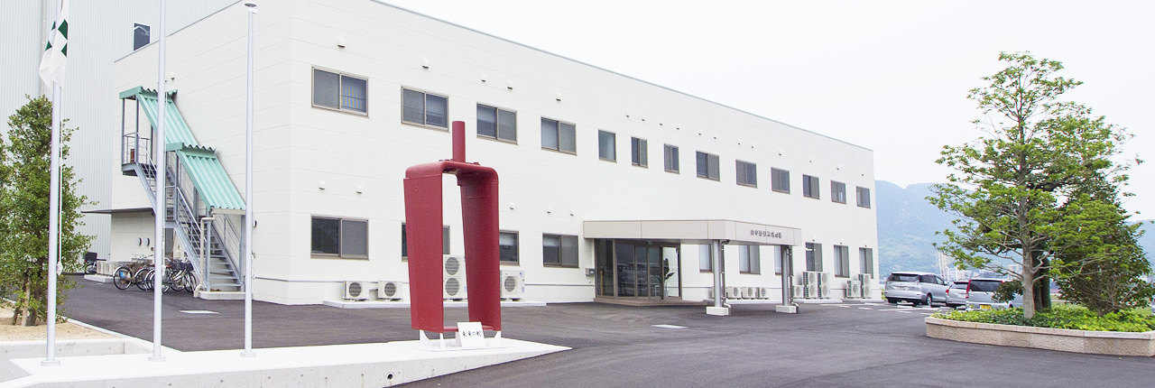
Shikoku 88 temples
山中造船
古代より伝わる輪くぐり神事
The First Gate Rudder is placed as an arch in front of Yamanaka Zosen
A circle (arch) that goes round from ancient times
Shikoku Pilgrimage
Kodai yori tsutawaru wakuguri shinji

Slide 17
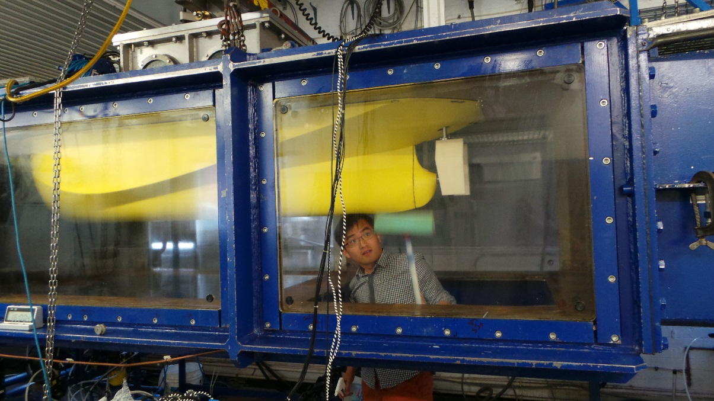
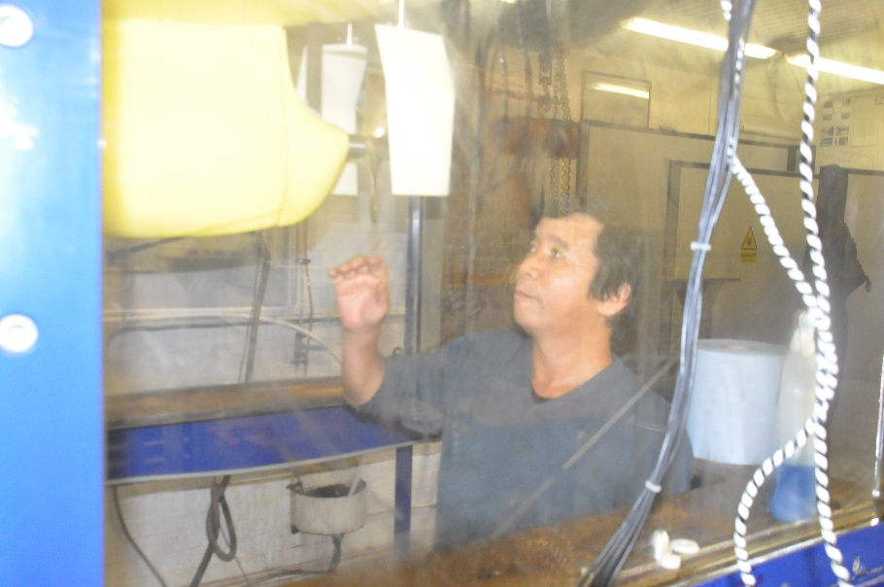
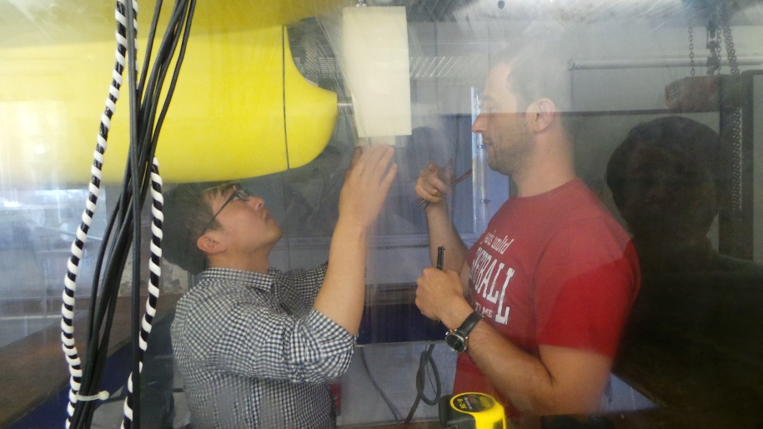
Thank you

